Slide 1

Vehicle Insurance
DayaNithi.E

Slide 2
Business Problem
The main objective behind this method is to increase sales revenue and profit from the already acquired customer base of a company , To optimize customer, reach out process, many insurance worker spend a lot of their time having meeting with prospective client without knowing the probability of that customer to buy the insurance product.
An insurance company that provides Health Insurance to its customers, usually they offer other insurance product to the customers through different kind of marketing channel. In this case we will build a model to predict whether the policyholders (customers) from past year will also be interested in Vehicle Insurance provided by the company
Cross-selling is perhaps one of the easiest ways to grow the business as they have already established a relationship with the client.
The Business can reduce the time they spend by convincing the non-ideal customers. With the help of the model, they can approach the ideal customers

Slide 3
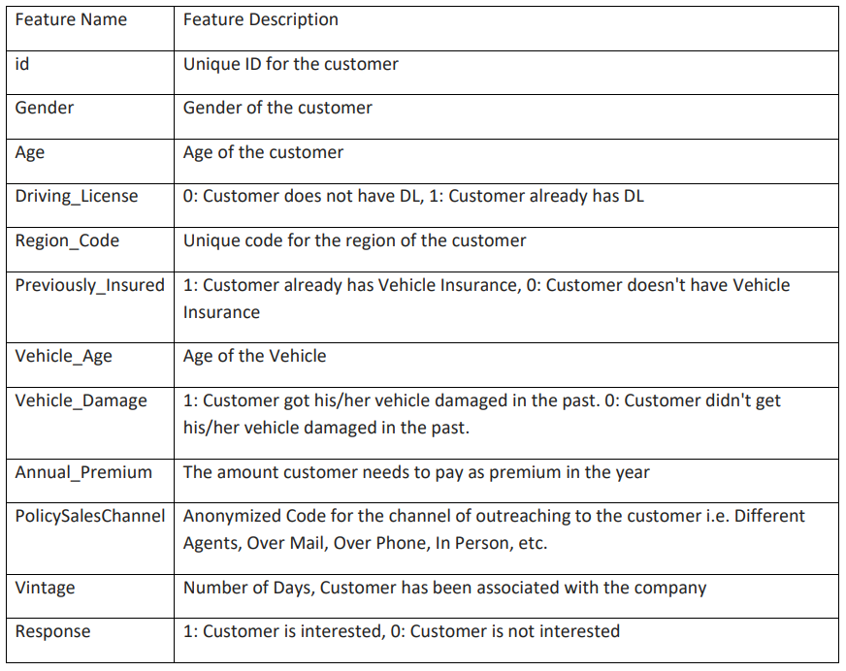
DATA Dictionary
There are about 381109 rows and 12 columns in the dataset with 9 numerical columns and 3 categorical columns.

Slide 4
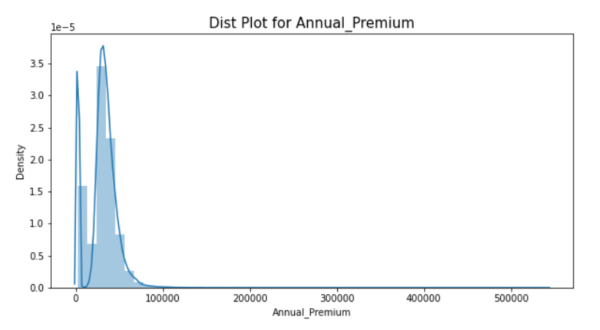
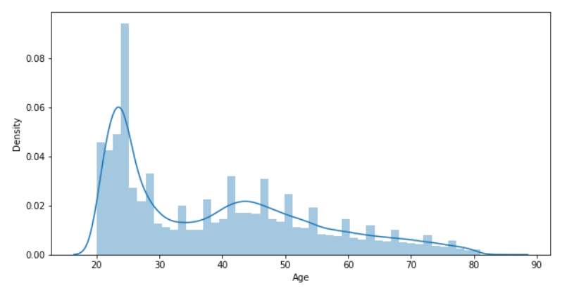
Most of the customers age range from 20 to 30
Almost all the annual premium ranges from 0 to 1000000

Slide 5
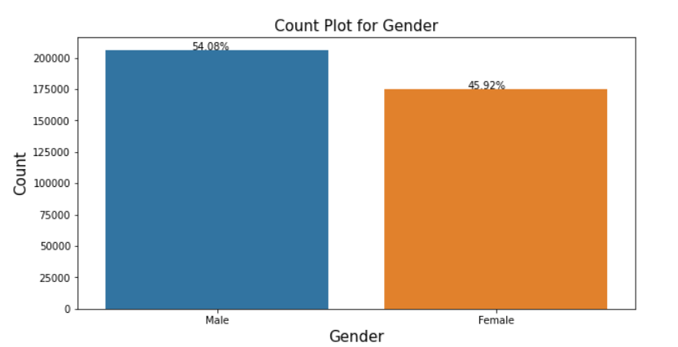
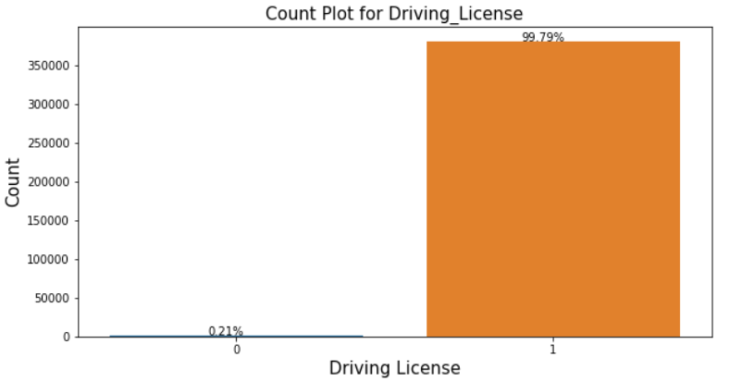
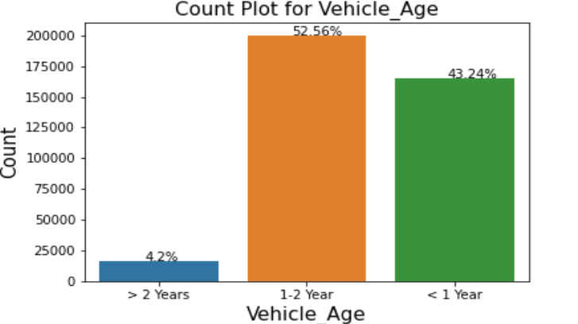
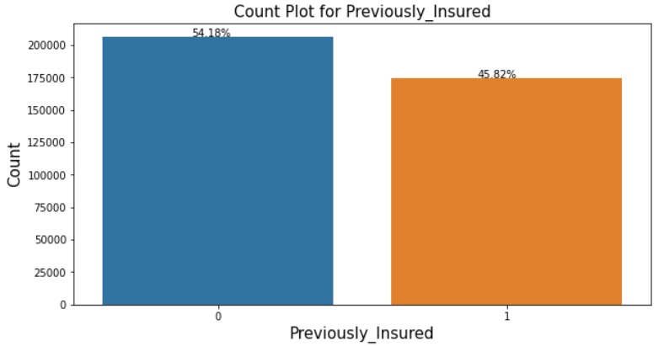
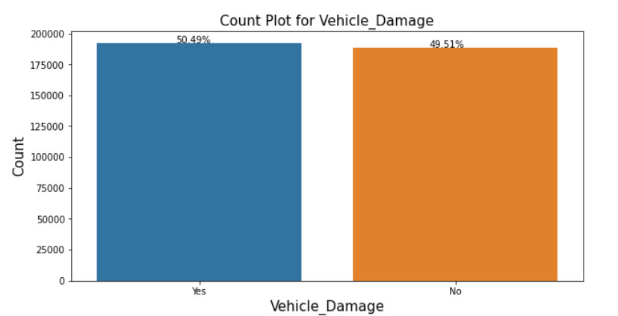
EDA
FIG-1 : Gender
FIG-2: Driving license
FIG-3 : Vehicle Age
FIG-4: Previously Insured Clients
FIG-5 : Damaged Vehicles

Slide 6
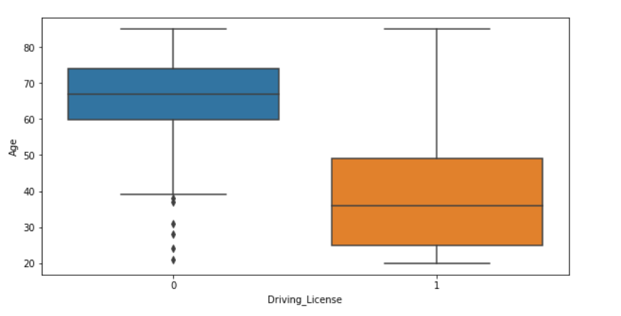
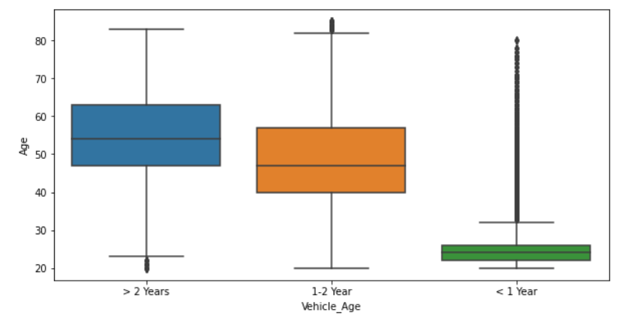
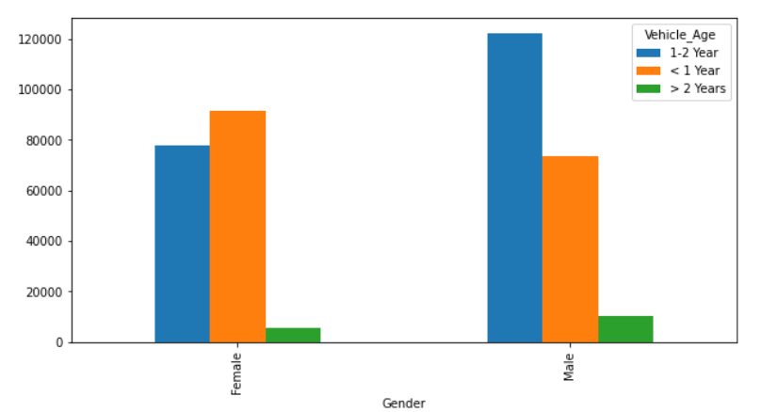
FIG-1 : Driving license & Age
FIG-2 : Vehicle age & customer Age
FIG-3: Gender & Vehicle age

Slide 7
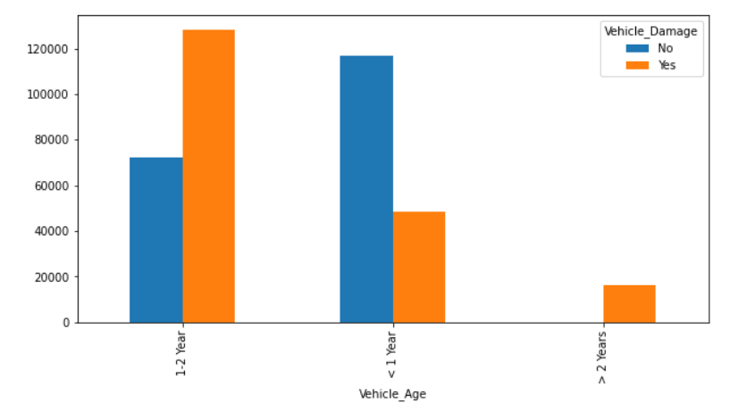
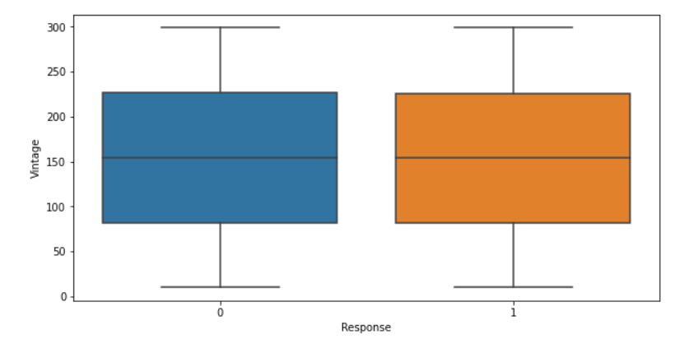
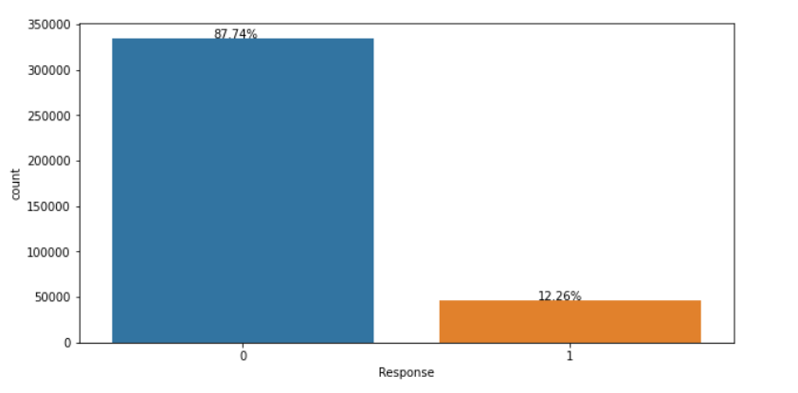
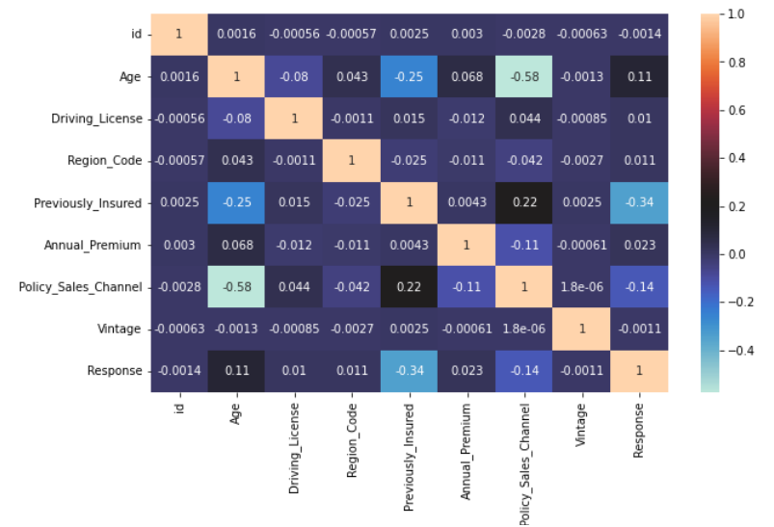
FIG-2: Selection of Target
Vintage & Response
FIG-1 : Vehicle Age & Vehicle Damage
FIG-3 : Imbalanced Target Variable

Slide 8
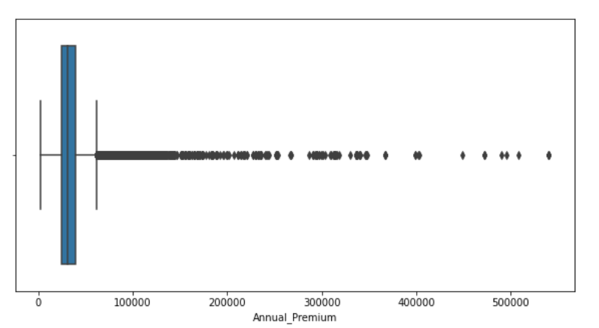
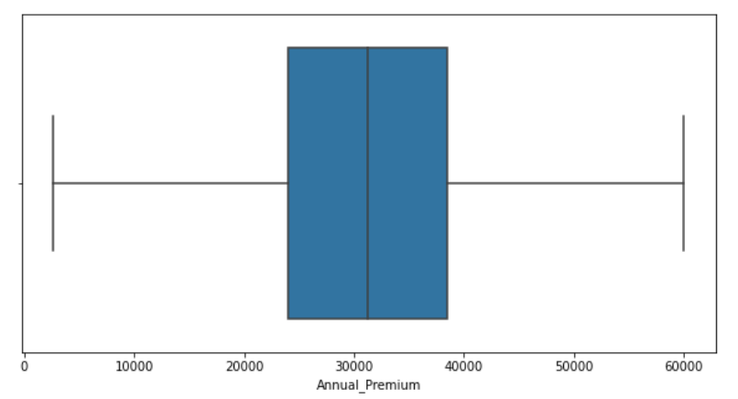
PREPROCESSING
Transformations are not required for now. Standard Scaling is required for all the numerical features . Encoding is required for categorical column. As Per Statistical Test Vintage Feature is insignificant hence it can be excluded for model building. In “Id” Feature all values are unique hence the values of this feature can be set as index for accessing the data.
Presence of Outlier
After Capping & IQR

Slide 9
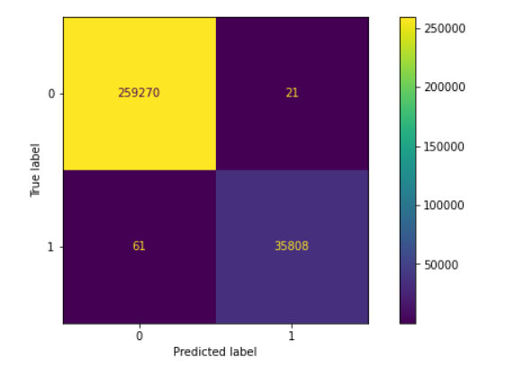
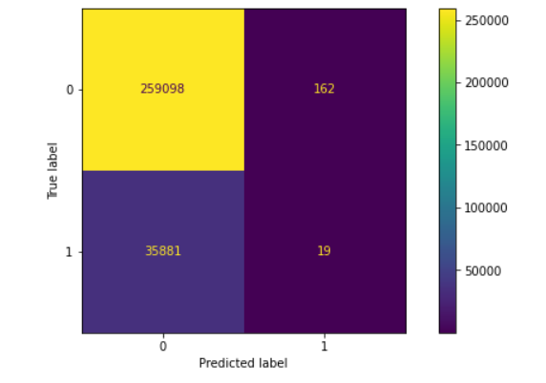
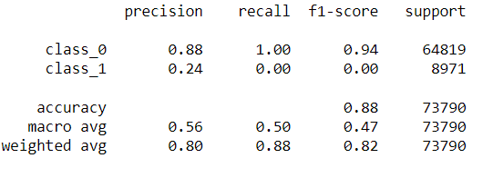
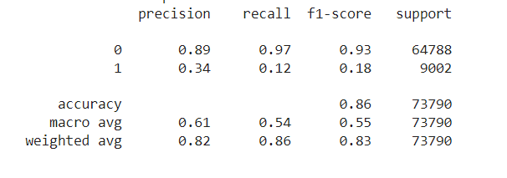
Base Models
Logistic Regression
Random Forest

Slide 10
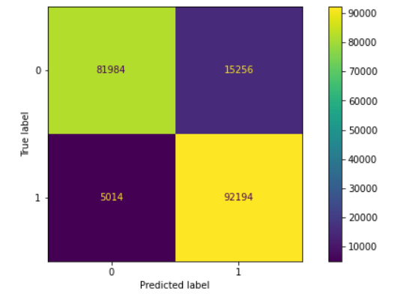
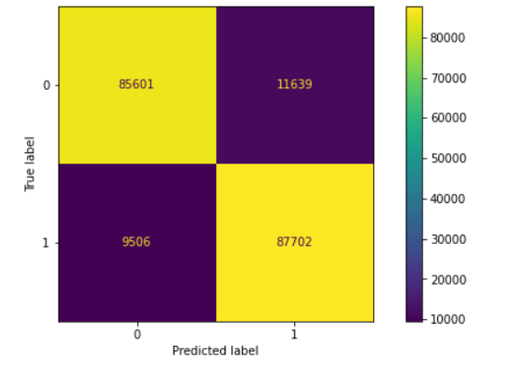
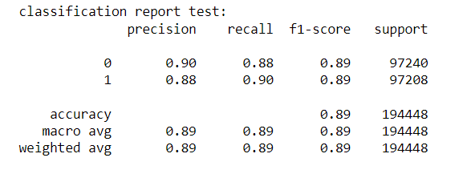
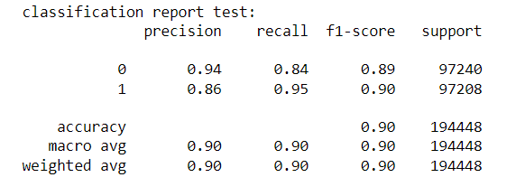
Decision Tree Classifier (SMOTE)
Random Forest (SMOTE)

Slide 11
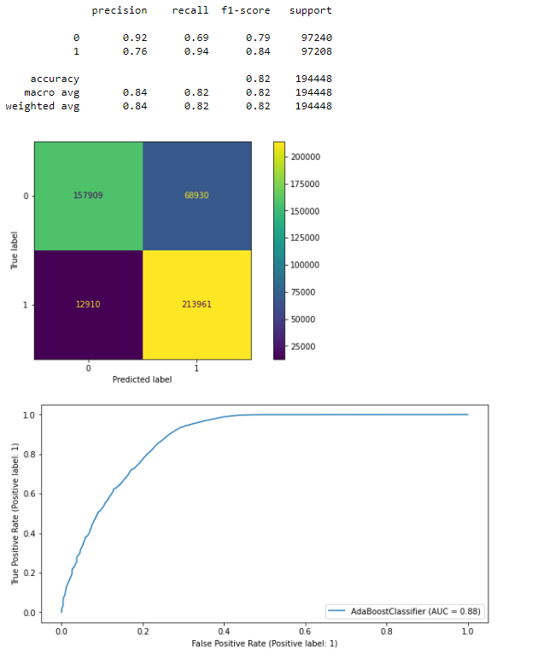
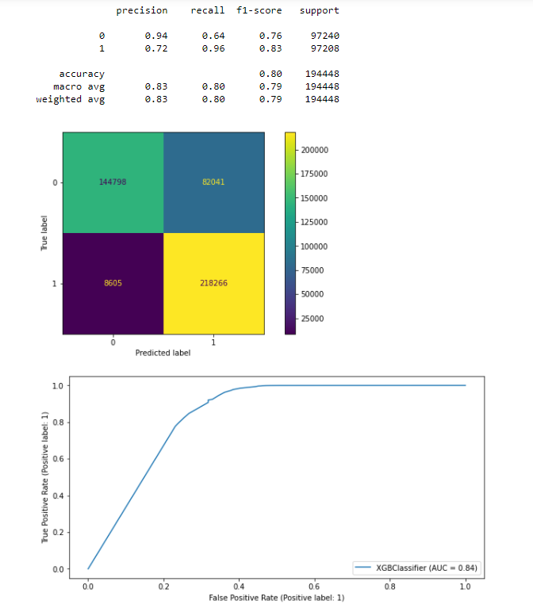
ADA Boost for Base Model
XGB Classifier for Base Model

Slide 12
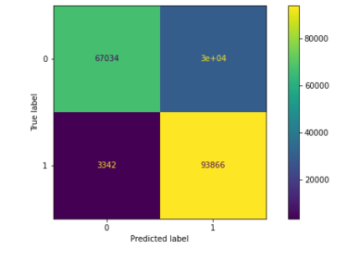
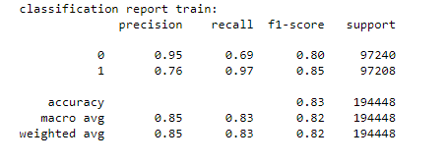
Random Forest
After Oversampling and Hyper parameter Tuning
Random Forest model has a better performance compared to all the other models .

Slide 13
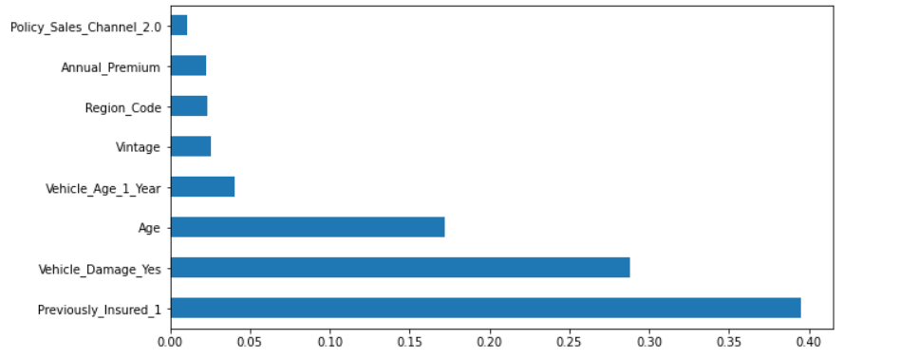
Feature Importance

Slide 14
Business Interpretation
If our model is deployed in production out of 100% of potential customers who are interested in availing vehicle insurance 96.5% of the customers will be predicted correctly by the model only, we will be losing 3.5% of the potential customers.
Hence the Marketing team does not require to cold call all of the customers and ask whether they are interested in availing vehicle insurance or not instead they could call the customers whom the model had predicted as interested customers. By this the marketing team will not waste their time in non-interested customers.

